Slide 1




Streetcar Project Data Collection Result Update
Prepared by CGIS | March 11th, 2014

Slide 2
ATLANTA DATA UPDATES
Population Data Analysis
Land Use/Development Analysis
Residential Development Analysis
Traffic Analysis
Hospitality

Slide 3
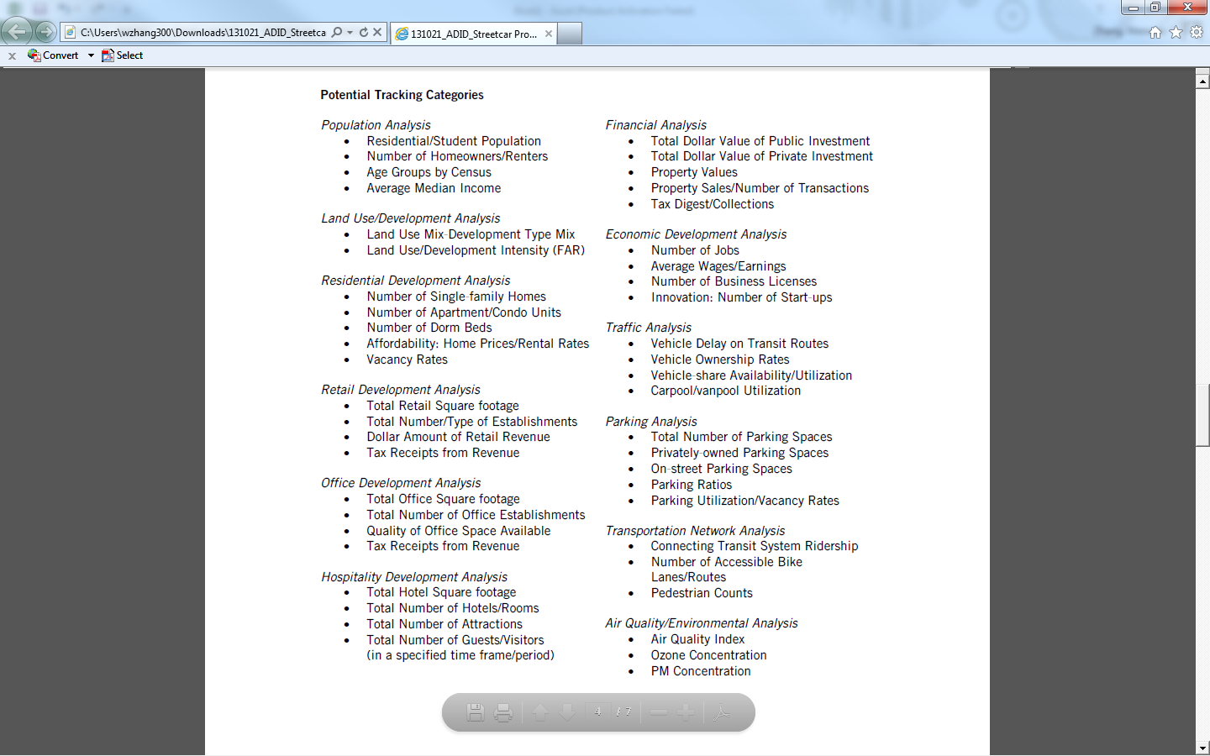
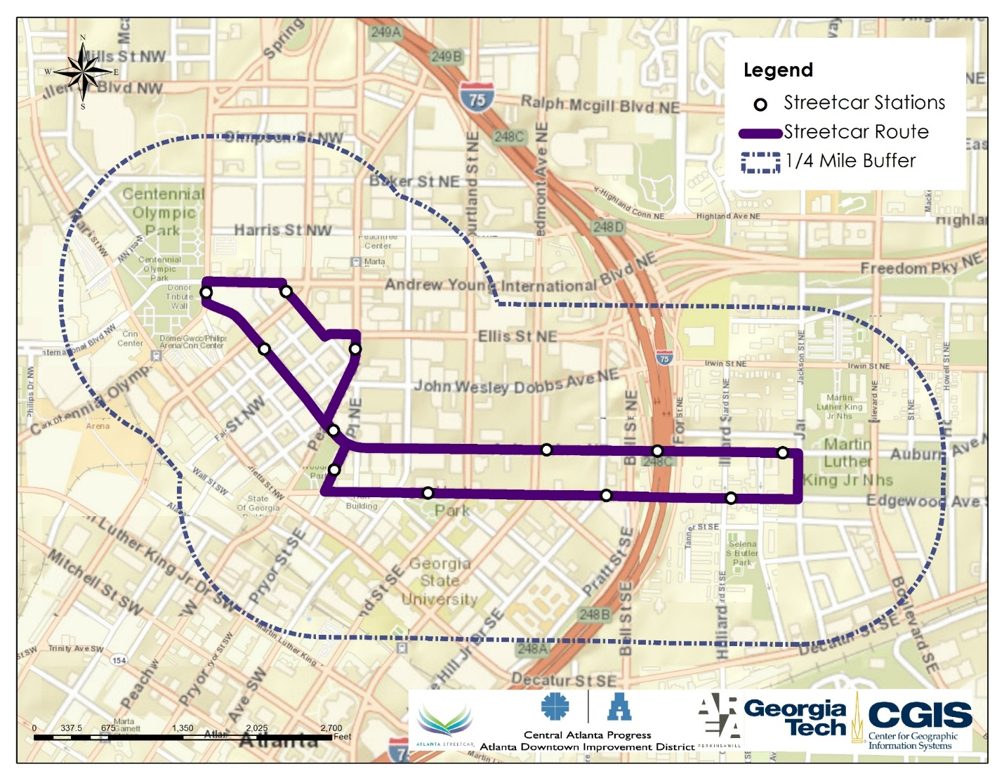
Population Data Analysis
2010 Residential/Student Population
Total Population: 6486
Student Population: 4010
Patton Hall: 325 Residents
Special Interest Housing (Greek Organizations)
9 Townhomes with 9-19 beds each
~ 135 Residents
University Commons: 2000 Residents
Piedmont North: 1100 Residents
University Lofts: 450 Residents
Piedmont North (1100)
University Commons(2000)
Patton Hall (325)
&Special Interest Housing (135)
University Lofts (450)

Slide 4
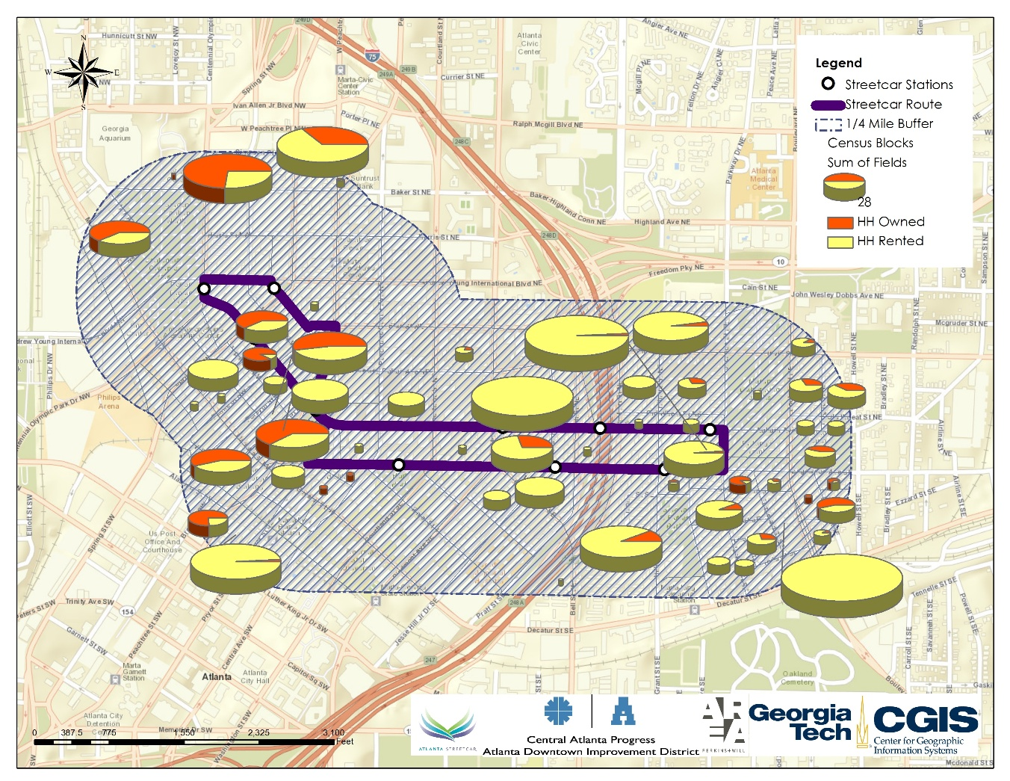
Population Data Analysis
Total Number of Occupied Households: 2173
Owned Households: 488
Owned Population: 711
Owned HH size: 1.456
Rented Households: 1685
Owned Population: 2366
Owned HH size: 1.404
Data Source: 2010 Census Block Data

Slide 5
Population Data Analysis
Median Income (Adjusted block group data)
Age Group Data
Income Category | Household Number | Percentage
Less than $10,000 | 569 | 26%
$10,000 to $14,999 | 181 | 8%
$15,000 to $24,999 | 172 | 8%
$25,000 to $34,999 | 160 | 7%
$35,000 to $49,999 | 274 | 13%
$50,000 to $74,999 | 365 | 17%
$75,000 to $99,999 | 226 | 10%
$100,000 to $149,999 | 122 | 6%
$150,000 to $199,999 | 60 | 3%
$200,000 or more | 44 | 2%
Age Group | Count | Percentage
Under 5 years | 222 | 3%
5 to 9 years | 134 | 2%
10 to 14 years | 94 | 1%
15 to 19 years | 1491 | 18%
20 to 24 years | 1692 | 20%
25 to 29 years | 979 | 12%
30 to 34 years | 788 | 9%
35 to 39 years | 577 | 7%
40 to 44 years | 474 | 6%
45 to 49 years | 436 | 5%
50 to 54 years | 397 | 5%
55 to 59 years | 330 | 4%
60 to 64 years | 255 | 3%
65 to 69 years | 159 | 2%
70 to 74 years | 108 | 1%
75 to 79 years | 75 | 1%
80 to 84 years | 70 | 1%
85 years and over | 70 | 1%

Slide 6
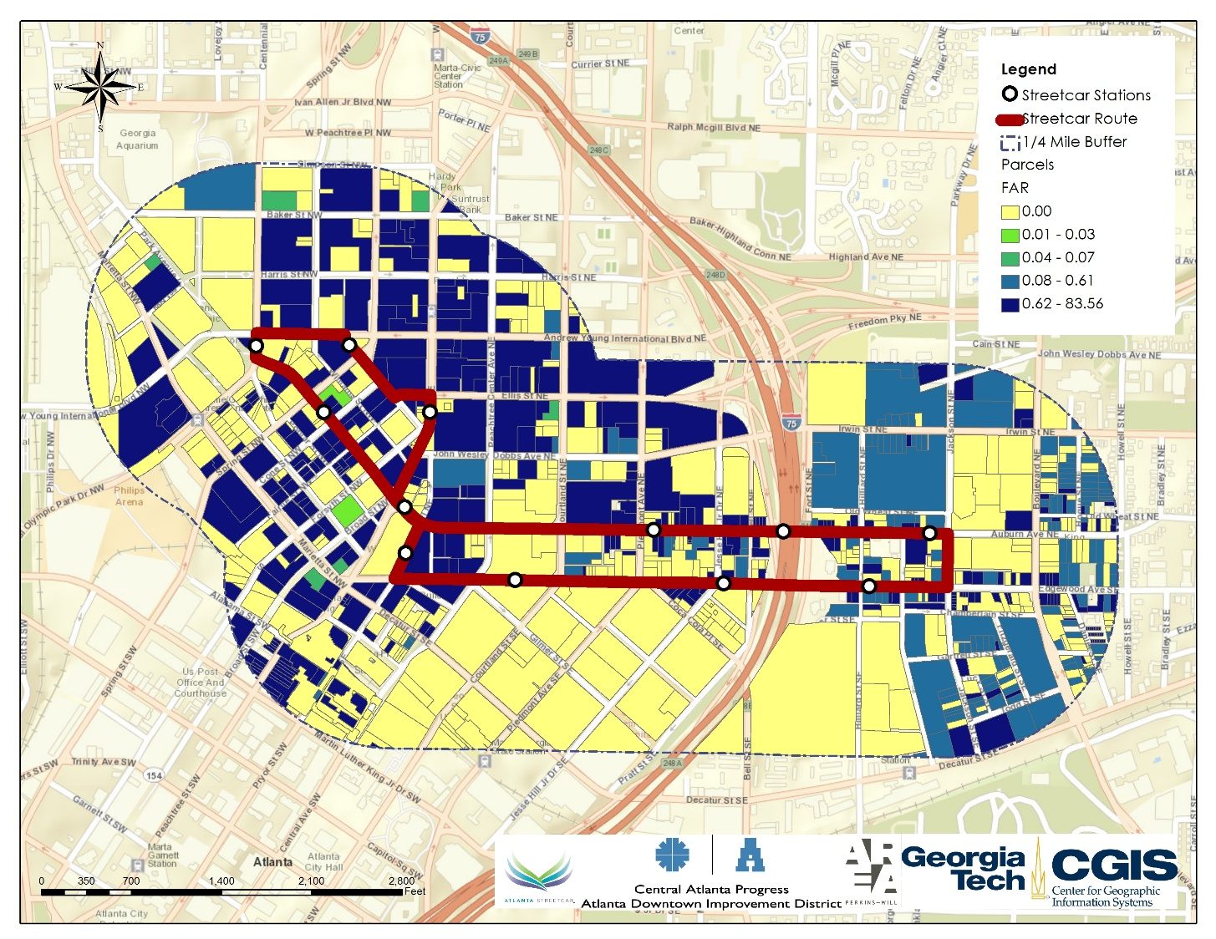
Land Use/ Development Analysis
Switched to parcel level of data
Land Use Type | Acres | Percentage | Vacant | Vacant Percentage
Residential | 64.0 | 13% | 6.9 | 11%
Commercial | 219.0 | 44% | 24.0 | 11%
Industrial | 2.4 | 0% | 0.1 | 6%
Institution | 203.1 | 41% | 32.6 | 16%
Utility | 8.7 | 2% | 1.7 | 20%
Total | 497.2 | 100% | 65.3 | 13%
Land Use/Development Intensity (FAR)
Range: 0-83.56 (191 Peachtree Tower)
Mean: 0.916
Source: 2010 Fulton Parcel Data from ARC/ 2013 Tax Assessor Data
Notes:
The major problem is that the parcel data doesn’t match up with the 2013 data. The FAR from tax assessor data is questionable. The highest value for FAR is actually more than 900000 (for some single family condos), which I don’t think is reasonable. These unreasonable data is deleted from the original data. The results displayed FAR result in the slides is obtained based on the subset of 2013 Tax assessor data.

Slide 7
Residential Development Analysis
Number of Single Family Homes: 107
Land use code: 101 Residential 1 family: 69
Land use code: 107 Single Family Residential Townhomes: 38
Number of Apartment/Condo Units: 1303
Land use code: 106 Residential condo: 36 with 1116 Units
Land use code:110 Residential loft: 5 with 103 Units
Land use code:2B2 Apt. High rise Class B: 1 with 84 Units
Number of Dorm Beds: 4010 (GSU)
Source: 2010 Fulton Parcel Data from ARC/ 2013 Tax Assessor Data

Slide 8
Traffic Analysis
Vehicle Share Availability/Utilization
5 Zip Car Stations
Spring/Baker Street
191 Peachtree Tower
Peach Tree Center Ave/ Ellis St
GSU Piedmont North Residential Hall
GSU Commons Deck
Carpool/Vanpool Utilization (ARC 2010 Travel Survey Data
Modes | Trips Originated from Study Area |  | Trips Attracted to Study Area
 | Weighted Trip # | % | Weighted Trip # | %
Walk | 84907 | 38.9% | 85585 | 39.0%
Bike | 1460 | 0.7% | 1249 | 0.6%
Auto/Van/Truck Driver | 73247 | 33.5% | 72999 | 33.3%
Auto/Van/Truck Passenger | 12119 | 5.6% | 10812 | 4.9%
Local Bus | 8444 | 3.9% | 8624 | 3.9%
Express Bus | 6526 | 3.0% | 6444 | 2.9%
Marta Train | 25985 | 11.9% | 27149 | 12.4%
Dial-a-Ride | 616 | 0.3% | 1626 | 0.7%
Taxi/Limo | 977 | 0.4% | 769 | 0.4%
School Bus | 2360 | 1.1% | 2360 | 1.1%
Motorcycle | 115 | 0.1% | 115 | 0.1%
Other | 1593 | 0.7% | 1593 | 0.7%
Total | 218350 | 100.0% | 219324 | 100.0%

Slide 9
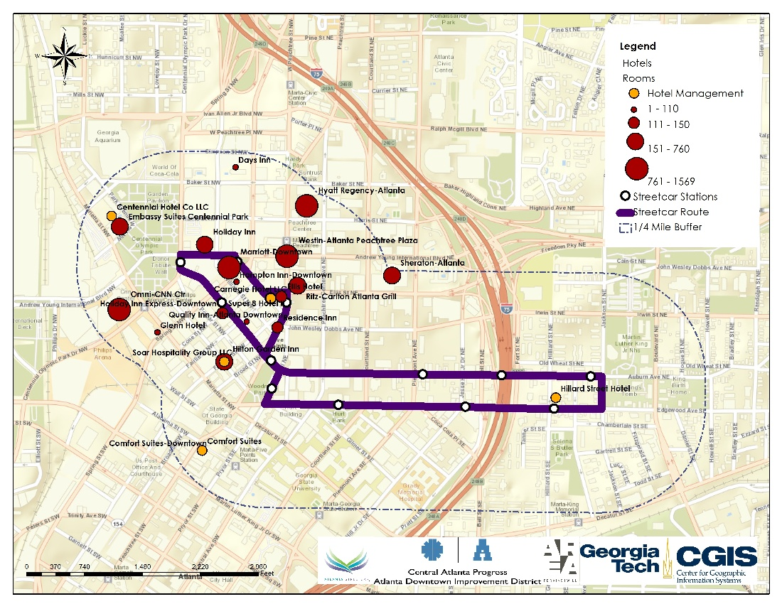
Hospitality Analysis
Number of Hotel: 19
Number of Rooms: 8043
Hotel Names | Total rooms
Westin-Atlanta Peachtree Plaza | 1068
Super 8 Hotel II | 130
Sheraton-Atlanta | 760
Ritz-Carlton Atlanta Grill | 444
Residence Inn | 124
Quality Inn-Atlanta Downtown | 75
Omni-CNN Ctr | 1070
Marriott-Downtown | 1569
Hyatt Regency-Atlanta | 1260
Hilton Garden Inn | 204
Holiday Inn | 260
Holiday Inn Express-Downtown | 130
Hampton Inn-Downtown | 110
Glenn Hotel | 110
Ellis Hotel | 127
Courtyard-Downtown | 150
Comfort Suites | 81
Days Inn | 50
Embassy Suites Centennial Park | 321

Slide 10
Benchmark Cities Data Collection Updates
Light Rail Shapefile Collection
GTFS: General Transit Feed Specification (GTFS)
Los Angeles
Denver
Salt Lake
Houston
Baltimore
Portland
Missing City: Phoenix and Charlotte
Study areas: Quarter-mile Buffer for each station

Slide 11
Population Data Analysis for Bench Mark Cities
Number of Homeowners/Renters
Benchmark City | HH# | HH_OWNED | POP_OWNED | HH_OWNED_SIZE | HH_RENT | POP_RENT | HH_RENT_SIZE | Total Population
Los Angeles | 61949 | 16798 | 57313 | 3.4 | 45151 | 125453 | 2.8 | 182766
Denver | 25798 | 7923 | 16656 | 2.1 | 17875 | 34044 | 1.9 | 50700
Salt Lake | 18528 | 7094 | 20072 | 2.8 | 11434 | 24250 | 2.1 | 44322
Houston | 9145 | 3149 | 7974 | 2.5 | 5996 | 12184 | 2.0 | 20158
Baltimore | 16458 | 5729 | 14099 | 2.5 | 10729 | 18520 | 1.7 | 32619
Portland | 19580 | 4056 | 6715 | 1.7 | 15524 | 21395 | 1.4 | 28110
Atlanta | 2173 | 488 | 711 | 1.5 | 1685 | 2366 | 1.4 | 3077

Slide 12
Population Data Analysis for Bench Mark Cities
Age Group

Slide 13
What’s Left
Atlanta
Completed
Still need to be estimated/collected
Waiting for CAP

Slide 14
What’s Left
Benchmark Cities
Completed

Slide 15
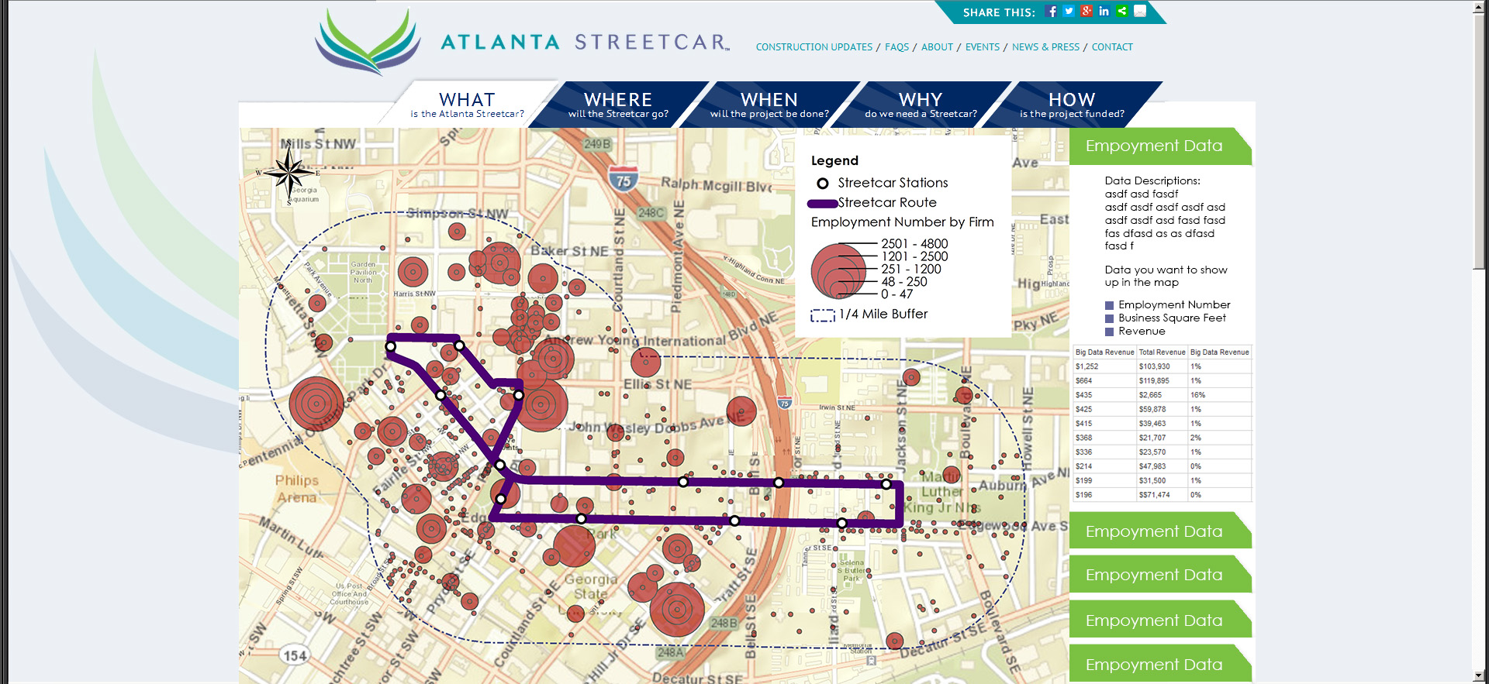
Web-based Data Portal Example

Slide 16
Thank You
Questions and Comments?

